Slide 1
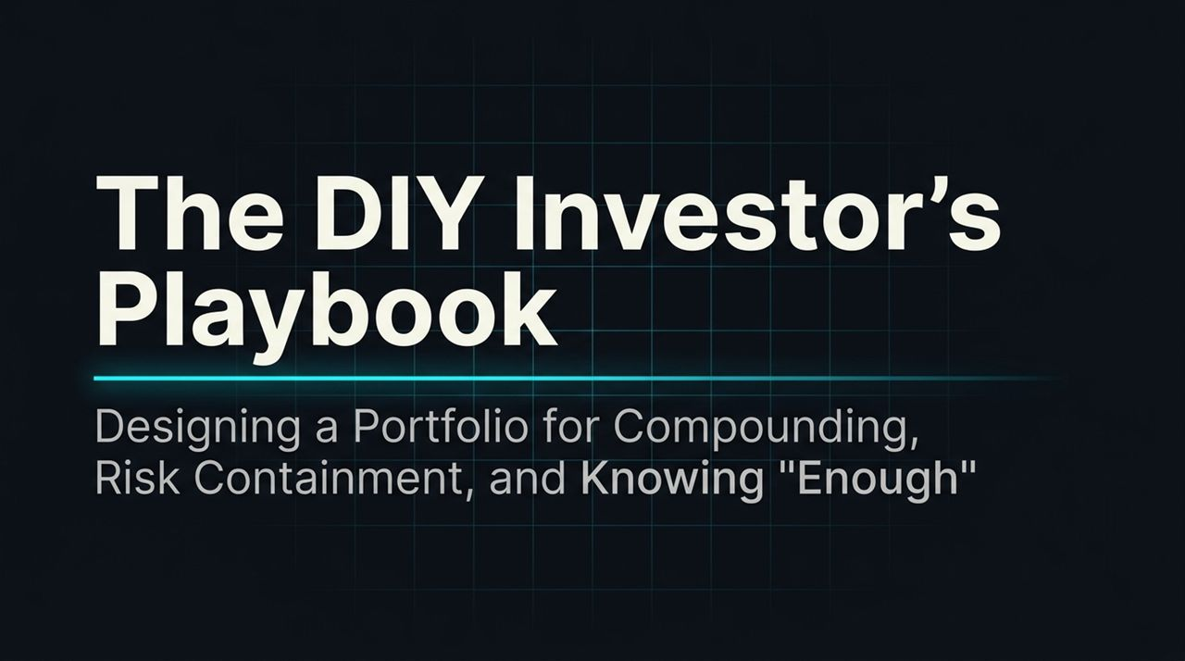
Notes:
Introduction: Welcome the audience. Explain that today’s topic is not about chasing stock tips, complex active trading, or getting rich overnight. It’s about building a sustainable, DIY strategy to reach true financial independence.
Contextual Framing: Introduce Ramin Nakisa (creator of PensionCraft), whose career spans quantitative finance, investment banking, and educating retail investors on sensible long-term wealth management.
Core Premise: The deck synthesizes two core pillars:
Structural discipline (how market mechanics, asset allocation, and low fees drive wealth creation).
Behavioral alignment (matching portfolio design with human psychology and defining "enough").
Transition: Let's start by analyzing why the traditional financial industry operates the way it does.
https://www.youtube.com/watch?v=E-gdRQS6NuU

Slide 2
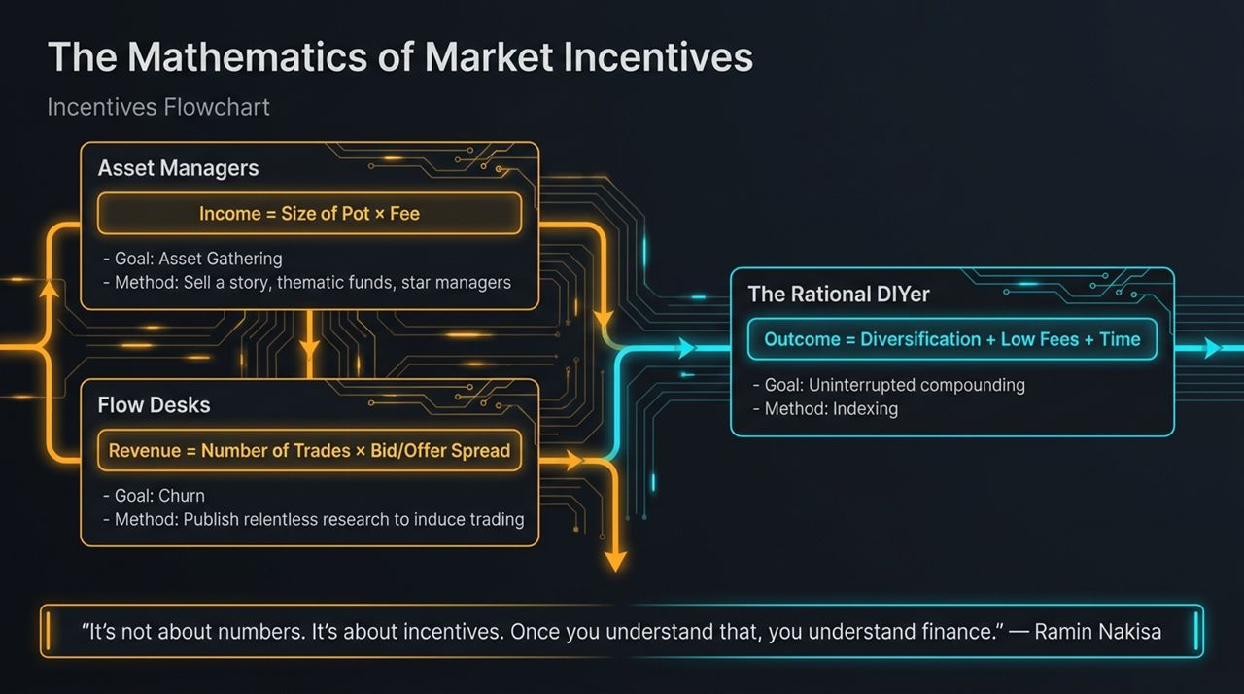
Notes:
Core Quote: As Ramin states, "It’s not about numbers. It’s about incentives. Once you understand that, you understand finance."
Deconstructing the Financial Industry:
Asset Managers: Their business is asset gathering ($Income=Size of Pot×Fee$). To grow the pot, they craft compelling narratives—thematic funds, AI hype, or star managers.
Flow Desks / Brokers: Their metric is transaction volume ($Revenue=Number of Trades×Spread$). They publish constant research and news alerts to induce churn and trading activity.
The DIY Solution: The rational DIYer cuts through this noise. The mathematical formula for success is simple: $\text{Outcome}=\text{Diversification}+\text{Low} \text{Fees}+\text{Time}$.
Takeaway: Your goal is uninterrupted compounding, which is best achieved through low-cost index investing rather than playing into Wall Street’s incentive structure.

Slide 3
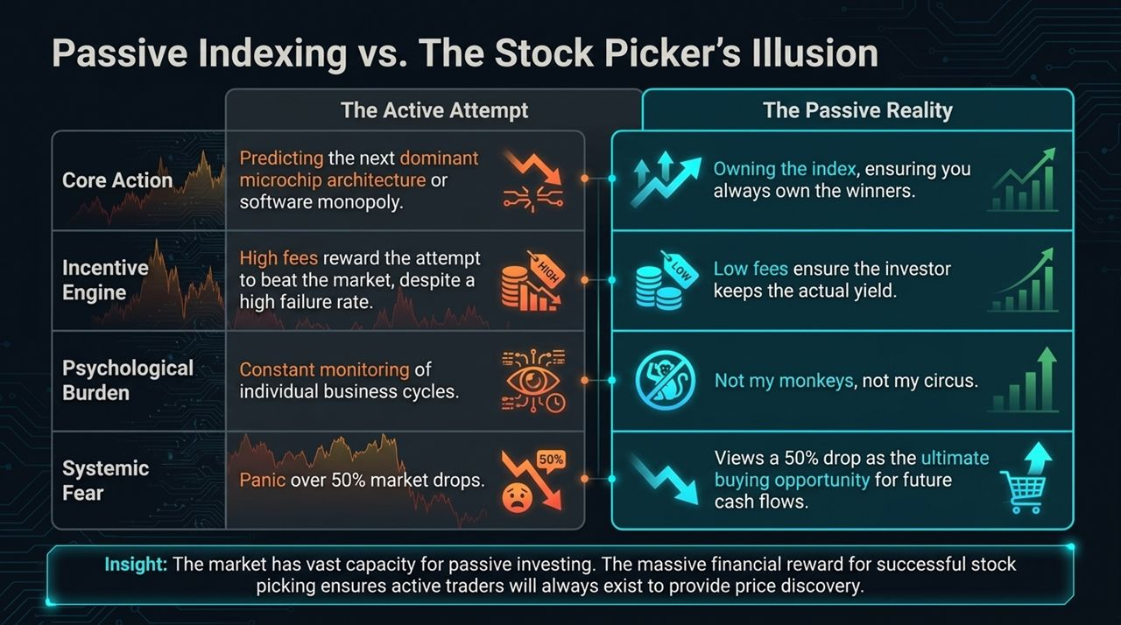
Notes:
Active Attempt vs. Passive Reality: Stock picking requires predicting individual business cycles, chip architectures, or monopolies. Active managers charge high fees despite a high failure rate over time. Passive indexing allows you to own the entire market index, guaranteeing you hold tomorrow’s winners without guessing.
The Psychological Burden: Active stock picking forces constant monitoring and anxiety. Passive indexing offers peace of mind ("Not my monkeys, not my circus").
Managing Market Crashes: When markets drop 50% (as seen in 2008–2009), active investors experience panic. Passive, long-term investors recognize market drops as prime buying opportunities to lock in future cash flows at discount valuations.
Systemic Insight: Passive indexing can scale extensively because the high financial rewards for successful stock picking ensure active traders will always exist to provide price discovery.

Slide 4
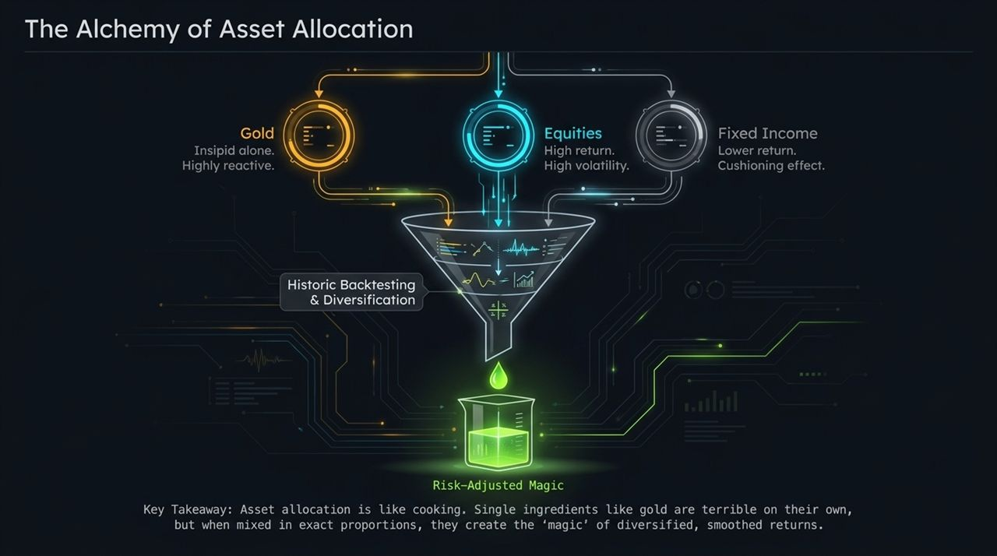
Notes:
The Culinary Metaphor: Ramin references Tyler from Portfolio Charts, comparing asset allocation to cooking.
Gold: Taken on its own, gold produces no yield and can be insipid or volatile.
Equities: High long-term growth and returns, but accompanied by heavy price volatility.
Fixed Income: Lower long-term returns, but acts as a stabilizing cushion during market drawdowns.
Risk-Adjusted Magic: Combining these assets in precise proportions smooths out volatility and improves risk-adjusted returns through true diversification.

Slide 5
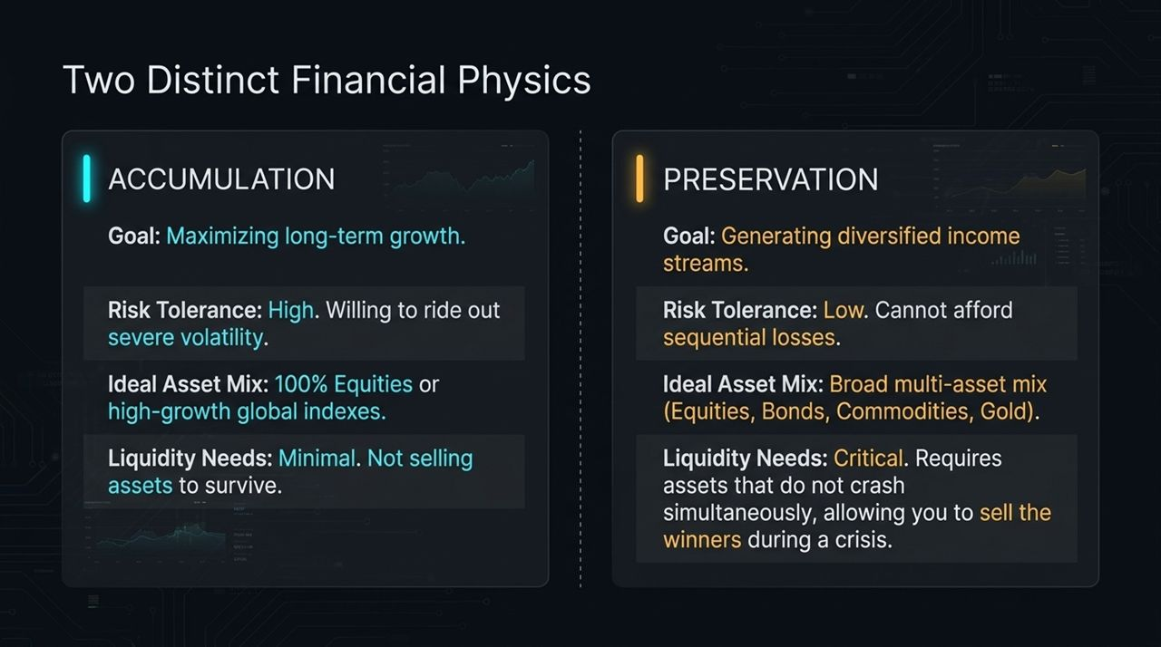
Notes:
Phase 1 — Accumulation:
Goal: Maximize long-term capital growth.
Profile: High risk tolerance, minimal short-term liquidity needs, ability to tolerate severe drops because you aren't liquidating assets to cover living expenses. Ideal mix: Up to 100% global equities.
Phase 2 — Preservation & Retirement:
Goal: Generate steady, multi-asset income while protecting capital.
Profile: Low risk tolerance; sequence-of-returns risk becomes fatal if forced to sell equities in a crash.
Solution: A multi-asset framework (Equities, Bonds, Commodities, Gold) ensures you always have a non-correlated, non-crashed asset class to sell during market distress.

Slide 6
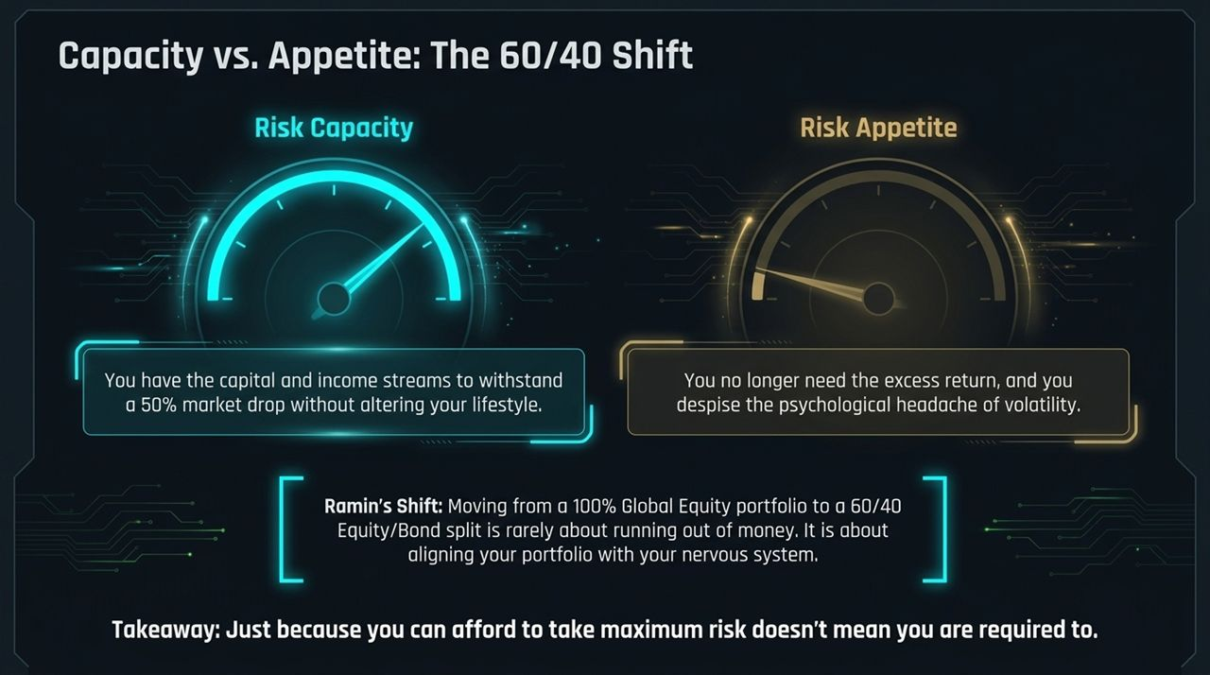
Notes:
Ramin's Personal Case Study: Ramin shifted his personal portfolio from 100% equities to a 60/40 equity/bond structure.
Risk Capacity vs. Risk Appetite:
Risk Capacity: Having the financial capital to absorb a 50% drop without changing your lifestyle.
Risk Appetite: The psychological willingness to endure volatility.
The "Enough" Realization: Once Ramin hit his target number, he no longer needed maximum equity returns to achieve his goals. His risk appetite naturally decreased.
Key Takeaway: Rebalancing into bonds/fixed income isn't always about running out of growth—it's about matching your portfolio design to your nervous system. Just because you can afford maximum risk doesn't mean you must take it.

Slide 7
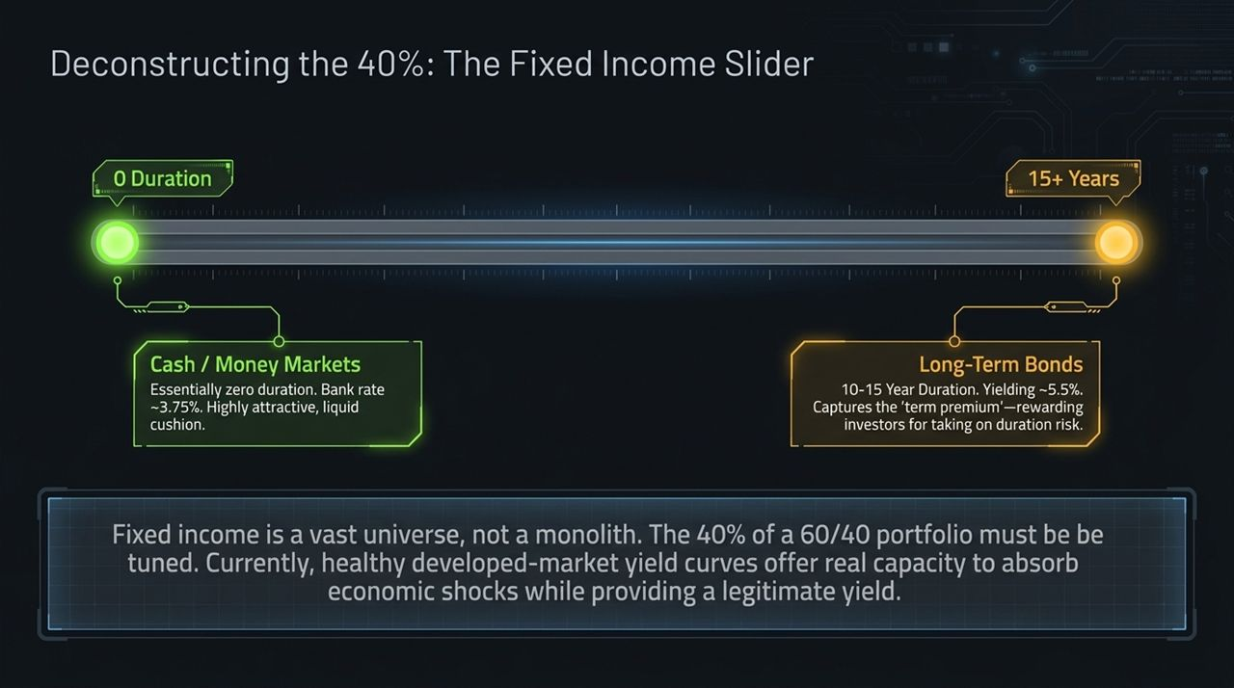
Notes:
Bonds Are Not a Monolith: Fixed income spans a broad continuum controlled by duration.
The Slider Mechanism:
0 Duration (Cash / Money Markets): Yields around 3.75%+. Liquid cushion with zero interest rate risk.
Longer Duration (10–15 Year Bonds): Yielding ~5.5%+. Provides term premium, locking in yield and protecting against broader economic shocks or rate cuts.
Current Market Dynamics: Developed-market yield curves now offer positive real yields and normalized term premiums, making the bond component a functioning shock absorber once again.

Slide 8
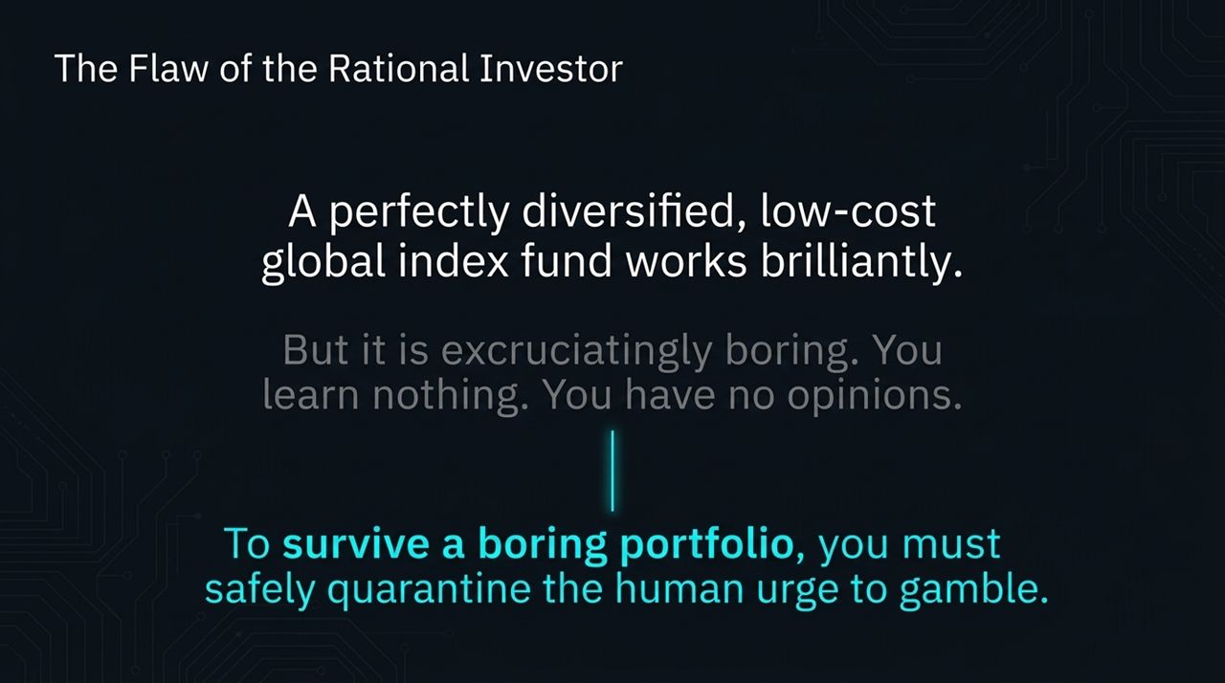
Notes:
The Rational Trap: On paper, an automated, low-cost global index portfolio is mathematically optimal.
The Human Element: In practice, passive investing is excruciatingly boring. Investors get curious, want to test market opinions, or feel the urge to trade.
Behavioral Leakage: If you don't build a safe outlet for curiosity, you risk blowing up your core strategy by making emotional, high-risk trades with your retirement money.
Solution: Quarantine the human urge to gamble inside a structured framework.

Slide 9
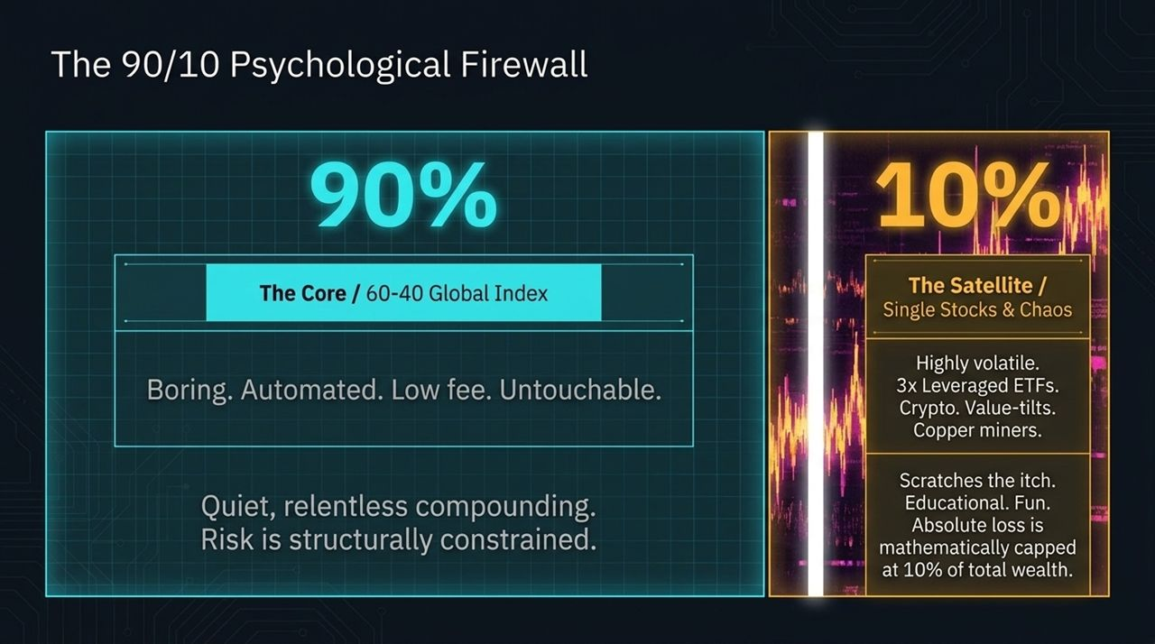
Notes:
Portfolio Division:
90% Core (The Vault): Held in an automated 60/40 global index structure. Low-fee, untouchable, and left alone to compound quietly.
10% Satellite (The Toy Box): A dedicated area for speculative plays—crypto, 3x leveraged ETFs, single stocks, or thematic bets (e.g., copper miners).
Why It Works: It "scratches the itch" for activity, market involvement, and learning without jeopardizing your financial security.
Risk Constraint: Your total speculative loss is strictly capped at 10% of total wealth.

Slide 10
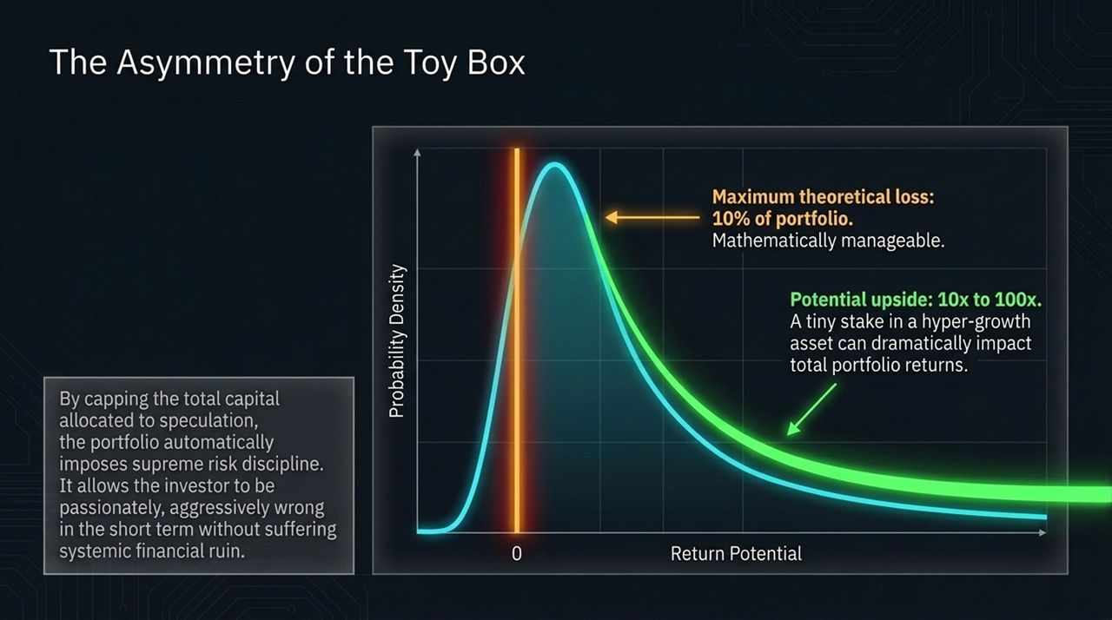
Notes:
Mathematical Structure: The 10% allocation operates on asymmetrical return profiles.
Downside Capped: The absolute worst-case scenario is a 10% loss to total net worth, which is manageable over a long compounding horizon.
Upside Convexity: High-octane assets can deliver 10x to 100x returns. A tiny position in a hyper-growth asset can meaningfully boost overall portfolio returns.
Behavioral Freedom: You give yourself permission to be aggressively wrong on short-term tactical ideas without putting your financial baseline at risk.

Slide 11
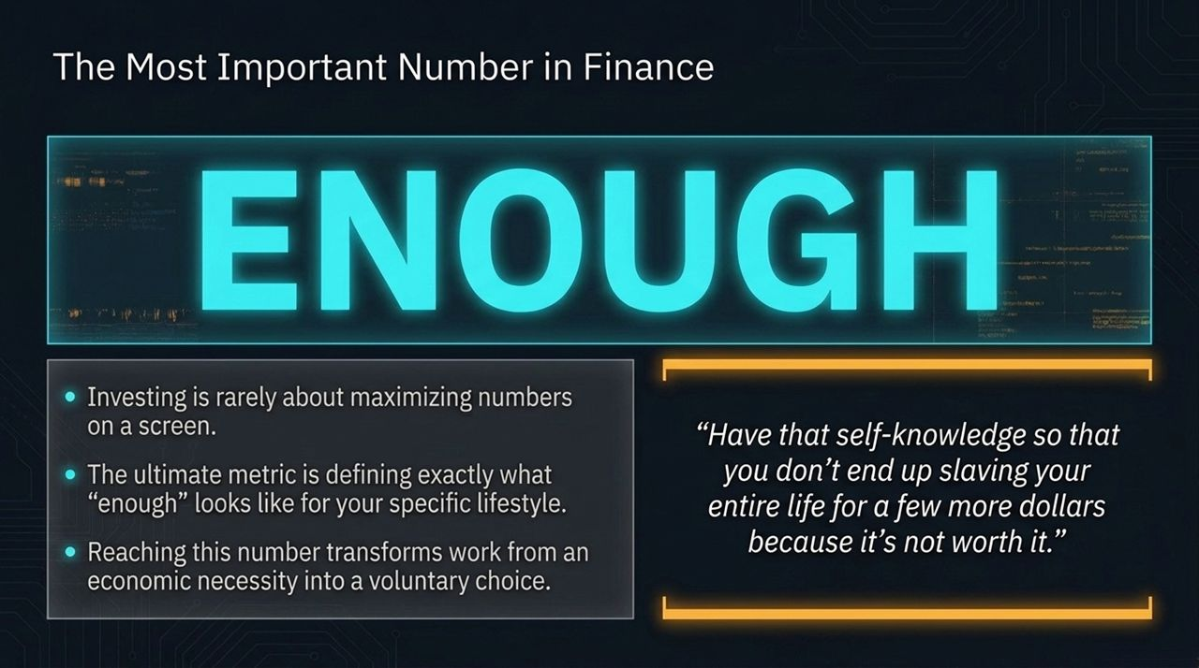
Notes:
Closing Takeaway: Ramin shares his primary core belief: "Investing is rarely about maximizing numbers on a screen. The ultimate metric is defining exactly what 'enough' looks like for your specific lifestyle."
Transforming Work: Reaching your "number" shifts work from an economic necessity to a voluntary choice.
Self-Knowledge: Without defining "enough," investors risk staying on a perpetual treadmill, taking unnecessary risks for marginal gains.

Slide 12
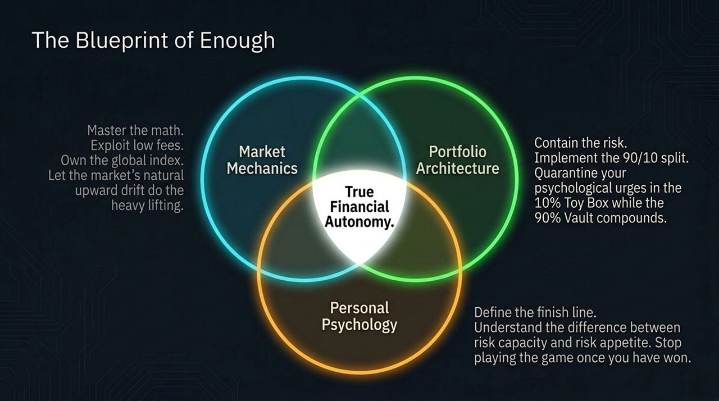
Notes:
Synthesizing the Framework:
Market Mechanics: Master low-cost index funds and let broad market growth carry the portfolio.
Portfolio Architecture: Enforce the 90/10 firewall to keep core assets safe while leaving room for speculative plays.
Personal Psychology: Match risk capacity with risk appetite and stop moving the goalposts once you hit your targets.
Goal: True financial autonomy.

Slide 13
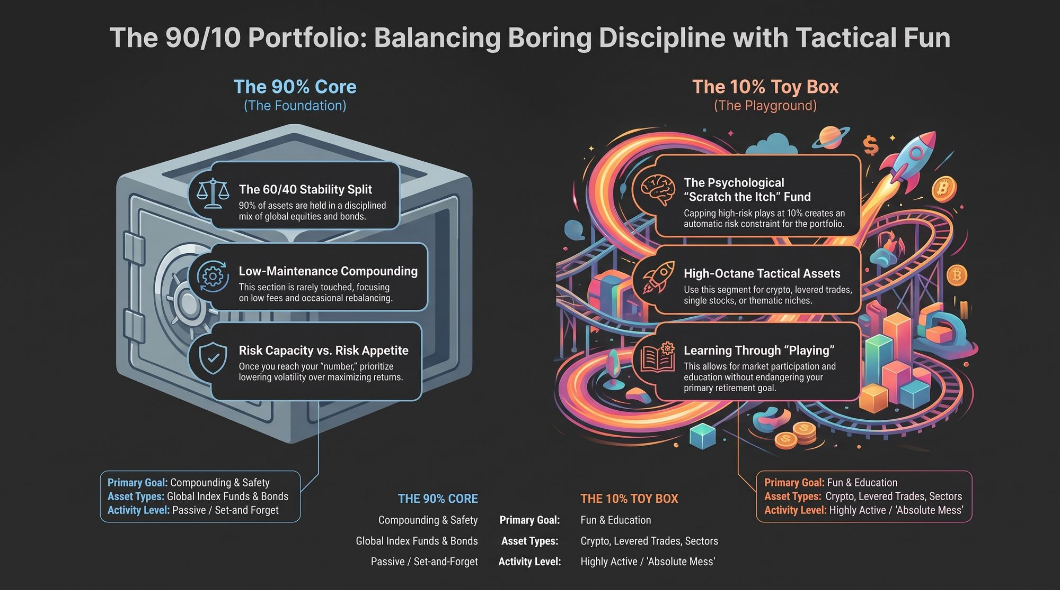
Notes:
Detailed Execution Summary:
90% Core Foundation: Focused on compounding and safety. Invested across global index funds and bonds via a set-and-forget approach.
10% Toy Box Playground: Focused on fun, tactical ideas, and hands-on learning. Active trading in crypto, sector tilts, or individual stocks is contained here.
Final Presentation Conclusion: Encourage the audience to review their portfolios through this lens: separate core wealth preservation from tactical speculation, reduce unnecessary fees, and focus on reaching their personal target.

